Slide 1



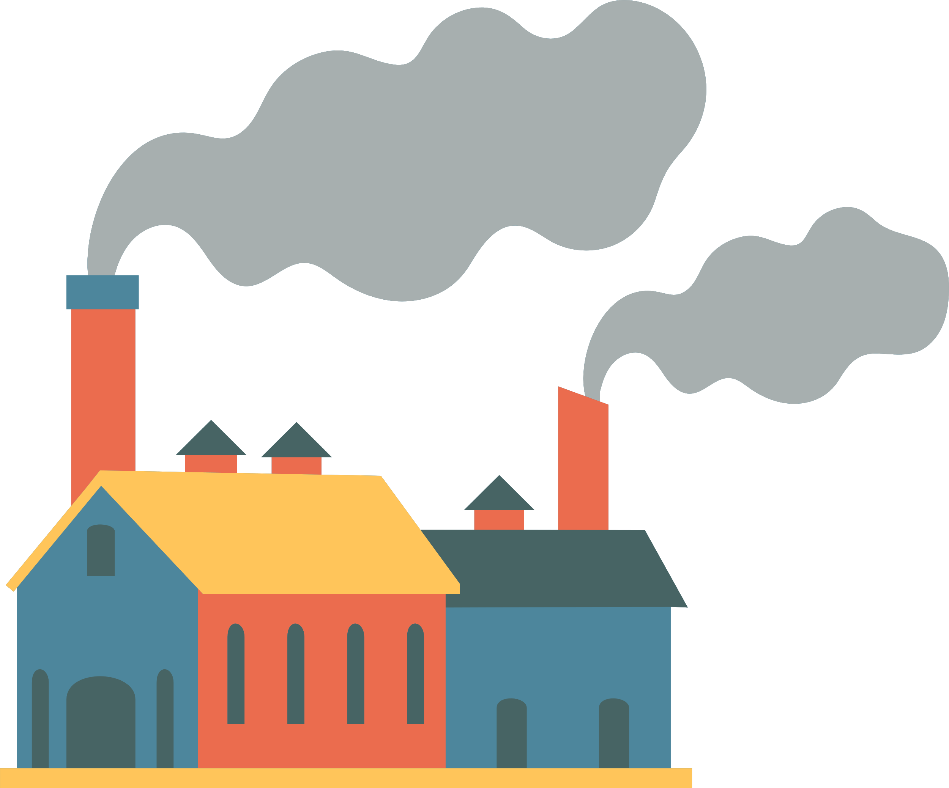

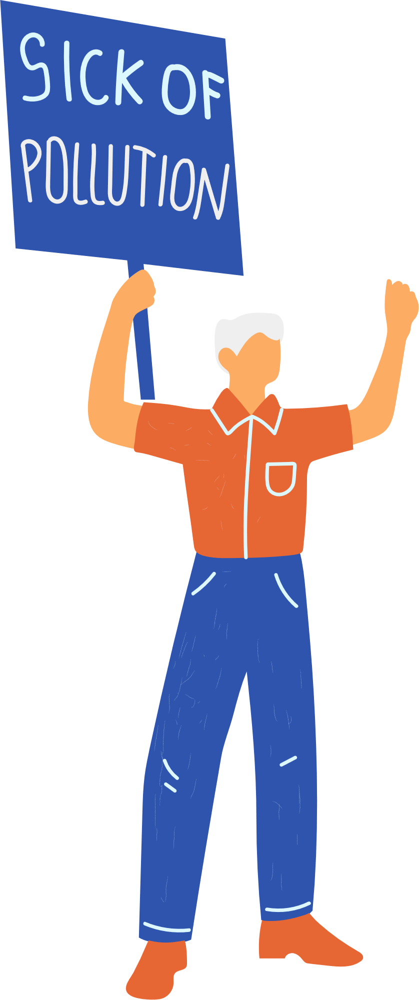

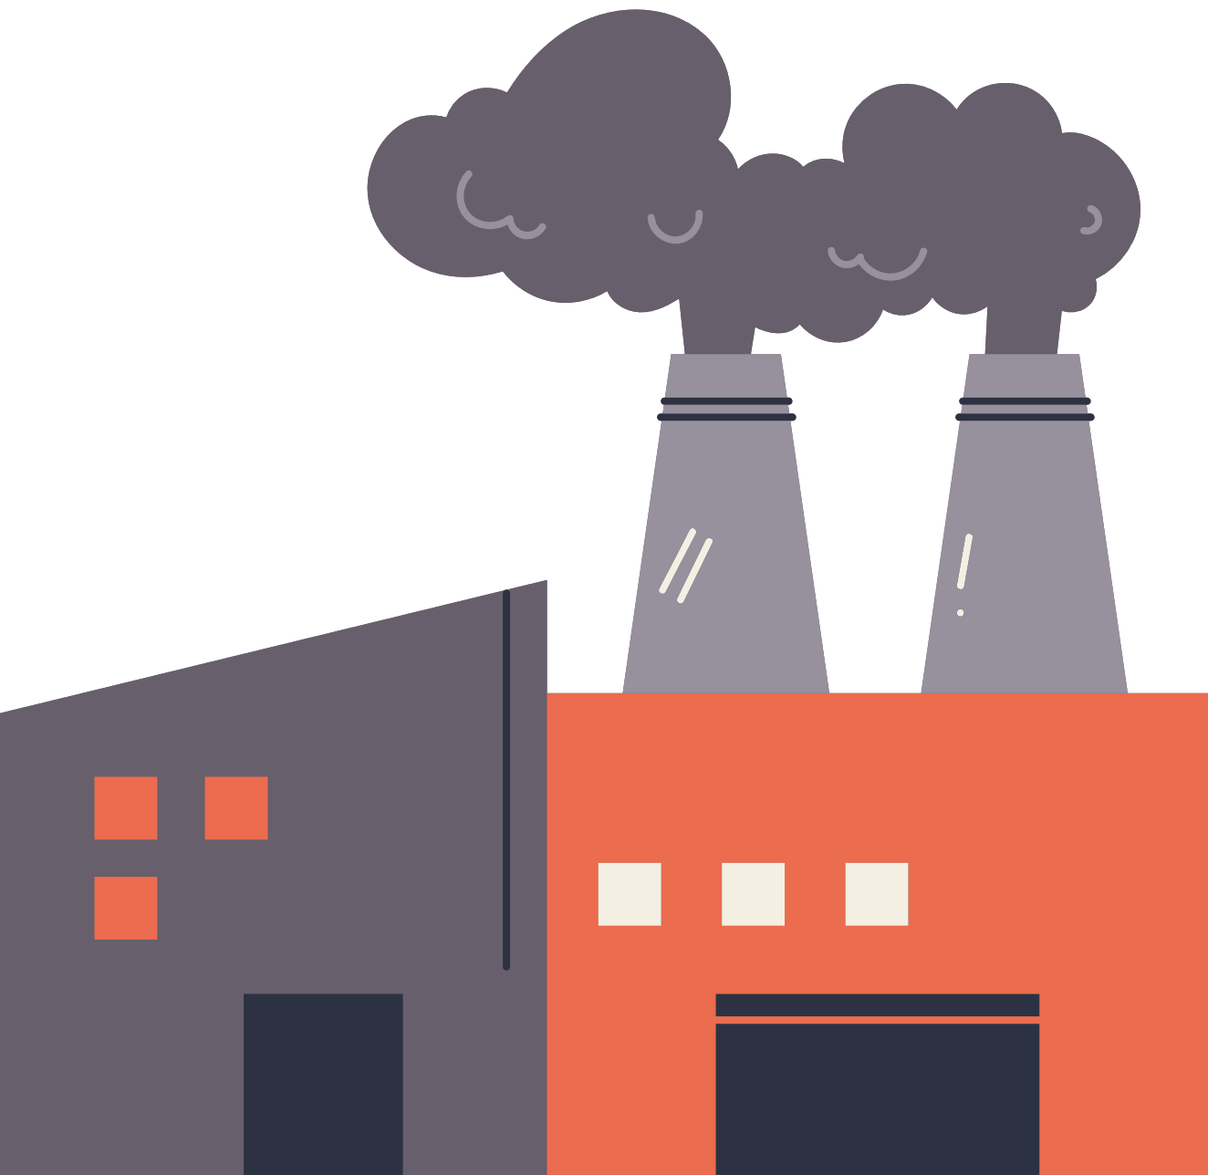
PRODUCT
MARKET FIT analysis
purifier
“Shared Responsibility for a Healthy Environment”

Slide 2


Problem statement
AIR PURE INNOVATIONS
What pollutants or particles should their air purifier target?
What are the most essential features that should be incorporated into the air purifier?
Which cities have the highest demand for air purifiers, and what is the market size in these regions?
What are the most essential features that should be incorporated into the air purifier?

Slide 3
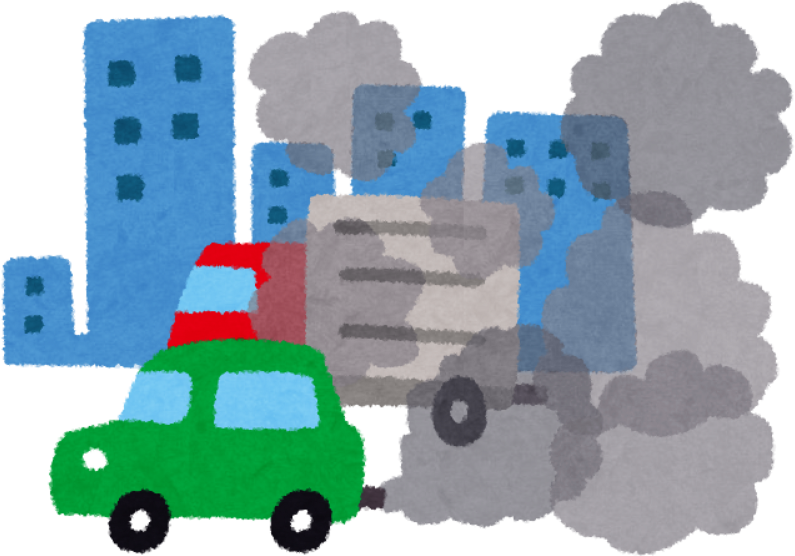
PRIMARY ANALYSIS

Slide 4
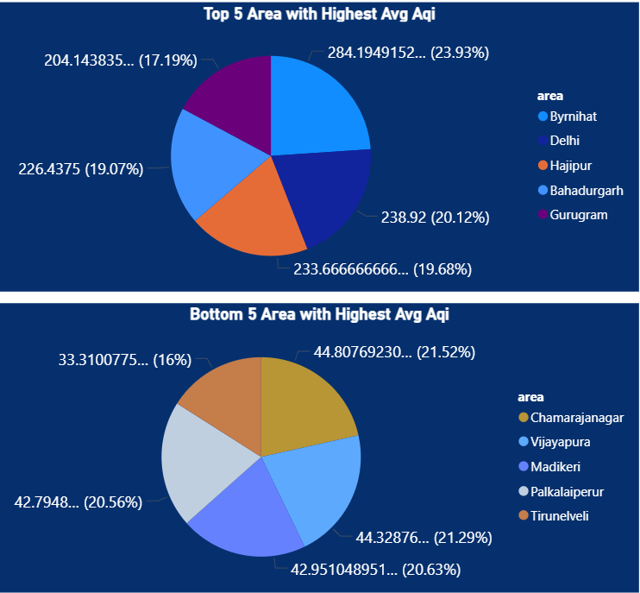
1. List the top 5 and bottom 5 areas with highest average AQI. (Consider areas
which contains data from last 6 months: December 2024 to May 2025)
Top 5 areas to focus on is:
BYRNIHAT
DELHI
HAJIPUR
BAHADURGARH
GURUGRAM

Slide 5
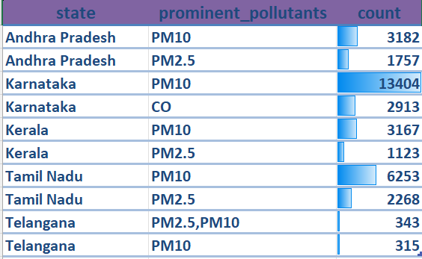
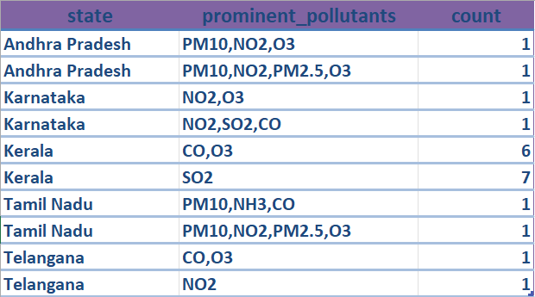
2.List out top 2 and bottom 2 prominent pollutants for each state of southern India.
(Consider data post covid: 2022 onwards)
TOP 2 POLLUTANTS
BOTTOM 2 POLLUTANTS
"PM10 and PM2.5 are among the most critical air pollutants that need to be effectively addressed for cleaner, healthier air."

Slide 6
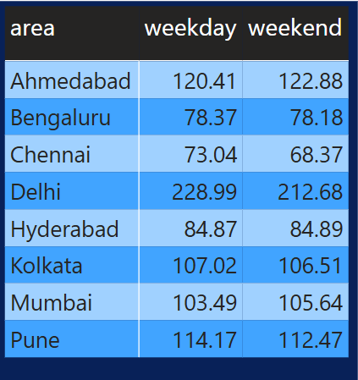
3. Does AQI improve on weekends vs weekdays in Indian metro cities (Delhi,Mumbai, Chennai, Kolkata, Bengaluru, Hyderabad, Ahmedabad, Pune)?
(Consider data from last 1 year)
"A striking pattern emerges across cities—while some breathe easier on weekdays, others find their cleanest air on weekends, revealing a dynamic rhythm in urban air quality."

Slide 7
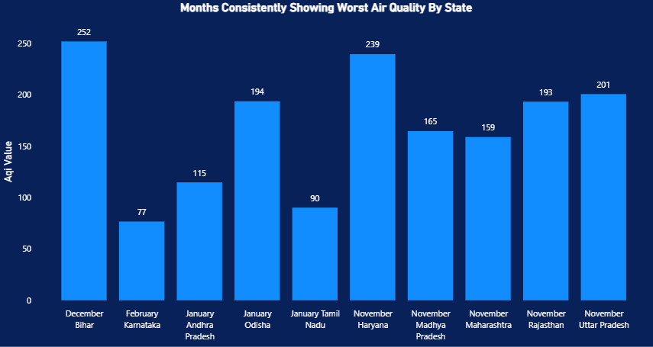
4. Which months consistently show the worst air quality across Indian states (Consider top 10 states with high distinct areas)
"November, December, and January consistently record the poorest air quality levels, likely due to a combination of seasonal factors such as lower temperatures, increased emissions, and atmospheric stagnation."

Slide 8
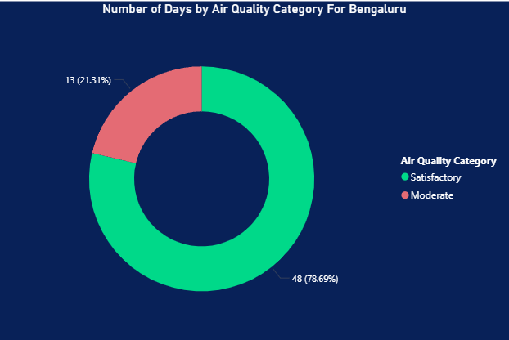
5. For the city of Bengaluru, how many days fell under each air quality category
(e.g., Good, Moderate, Poor, etc.) between March and May 2025?
"In Bengaluru, air quality consistently falls within the 'Moderate' and 'Satisfactory' categories, with no instances recorded under the 'Good' category."

Slide 9
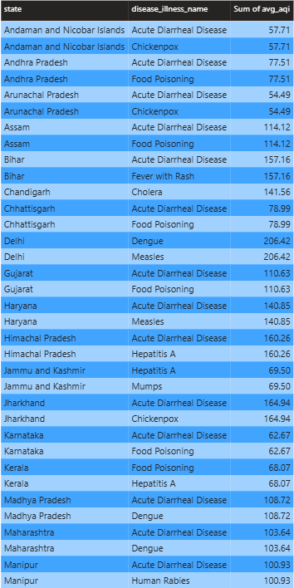
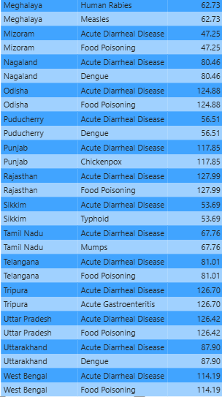
6. List the top two most reported disease illnesses in each state over the past three years, along with the corresponding average Air Quality Index (AQI) for that
period.
"Acute diarrheal disease appears to be prevalent across the majority of states."

Slide 10
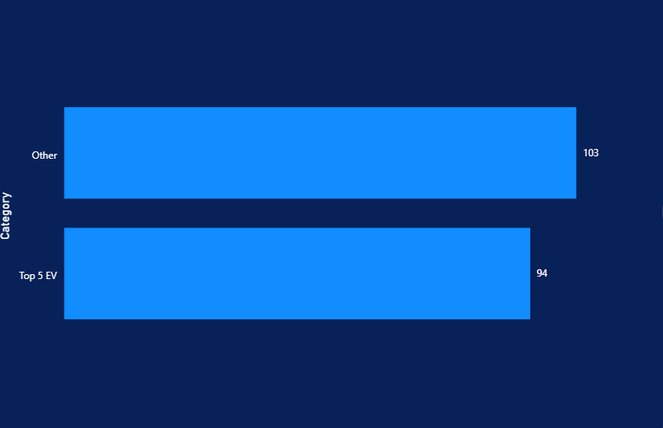
7. List the top 5 states with high EV adoption and analyse if their average AQI is
significantly better compared to states with lower EV adoption
"States with higher electric vehicle (EV) adoption tend to exhibit lower Air Quality Index (AQI) levels, whereas states with lower EV adoption generally experience higher AQI levels."

Slide 11
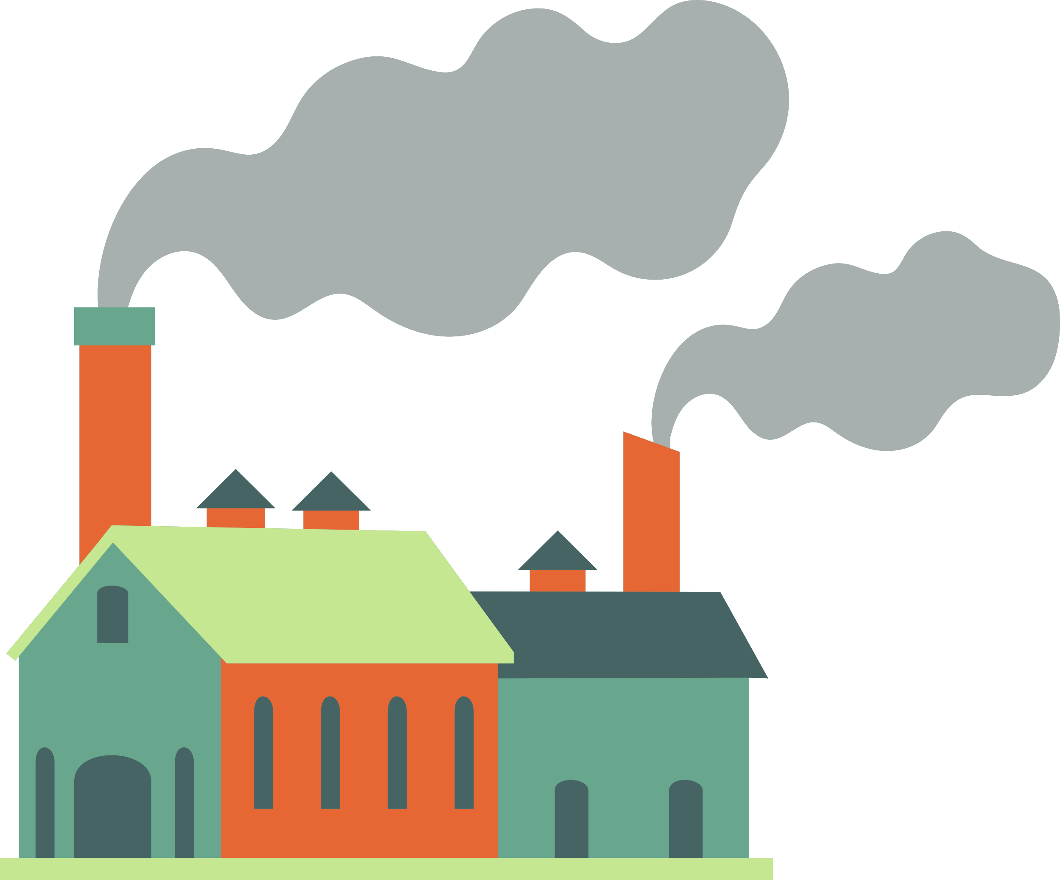
SECONDARY ANALYSIS

Slide 12
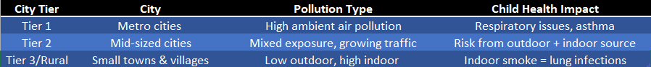
1. Which age group is most affected by air pollution-related health outcomes — and how
does this vary by city?
Most affected age groups (India context) Children (especially under 5 years)
Developing lungs, higher breathing rates, more outdoor activity.
Higher risk of acute respiratory infections, asthma onset, and long-term lung function loss.
Multiple Indian studies and WHO estimates show disproportionate burden of air-pollution-attributable lower respiratory infections in under-5 mortality.

Slide 13
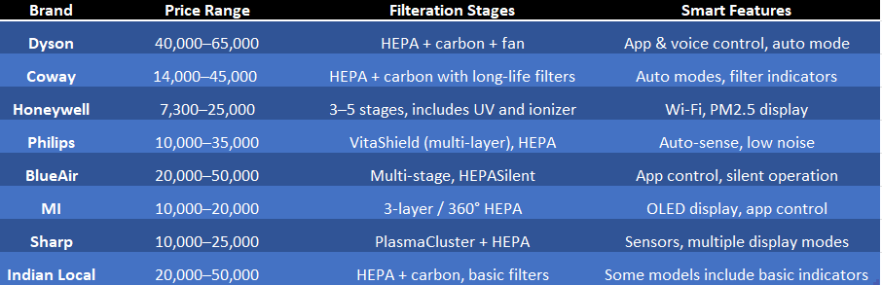
2. Who are the major competitors in the Indian air purifier market, and what are their key
differentiators
HEPA - High-Efficiency Particulate Air

Slide 14
3. What is the relationship between a city’s population size and its average AQI — do larger
cities always suffer from worse air quality?
Larger cities often face worse air quality, but it's not a universal rule.
Major urban centers like Delhi, Mumbai, and Kolkata frequently record high AQI levels—Delhi, for example, remains one of the most polluted cities worldwide, especially during winter months
Meanwhile, mid-sized cities like Jaipur (population ~4.3 million) also experience severe air pollution peaks (AQI over 300), despite being less densely populated.
Smaller towns and non-metros like Byrnihat have been among India’s most polluted cities in certain months, even surpassing larger cities in average PM₂.₅ concentrations.
Climate, geography, and local factors matter a lot.
Bengaluru, despite being a large metro, often enjoys lower AQI (<100) due to beneficial geography—like wind patterns and elevation—that naturally disperse pollutants

Slide 15
4. How aware are Indian citizens of what AQI (Air Quality Index) means — and do they
understand its health implications?
General Awareness
Familiar with “Air Pollution” but not technical terms
A perception study across 17 cities (5,000 respondents) found that awareness of air pollution itself is high (~95%), with most people believing it negatively impacts health.
However:
Only ~35% fully understood what AQI meant.
Awareness of terms like PM2.5 and PM10 was significantly lower, especially among less-educated respondents.
(Asar-Annual status Education Report)
In a similar survey in the Delhi-NCR region:
Just 10% of urban poor (e.g., slum residents) understood terms like AQI or PM2.5, while 71% of middle-class residents did.
Belief strong, information-seeking weaker
Around 93% of respondents agreed air pollution harms health, and 80% said it affects their quality of life.
Scroll.in
Yet only 13% actively sought air quality information.

Slide 16
5. Which pollution control policies introduced by the Indian government in the past 5 years
have had the most measurable impact on improving air quality — and how have these
impacts varied across regions or cities?
1.National Clean Air Programme (NCAP) has shown some measurable reductions in particulate pollution (PM₁₀/PM₂.₅) in many monitored cities, but progress is uneven and far from the 40% target in several locations.
2.Vehicle emission standard upgrade (BS-VI, 2020) produced clear, measurable cuts in vehicle-tailpipe pollutants (NOₓ, PM) in real-world studies and emission inventories — a durable win for urban air quality.
3.Graded Response Action Plan (GRAP) and short-term traffic interventions can reduce acute pollution spikes when strictly implemented but are reactive and effects are temporary/varied by enforcement.
4.COVID-19 lockdowns offered the clearest evidence that reducing traffic & industry lowers NO₂ and PM rapidly — but those improvements were temporary and do not indicate sustainable policy alone.
5.Vehicle emission standard upgrade (BS-VI, 2020) produced clear, measurable cuts in vehicle-tailpipe pollutants (NOₓ, PM) in real-world studies and emission inventories — a durable win for urban air quality.

Slide 17
🌬️ Air Purifier Product Recommendation & Feature Guide
Feature | Purpose | Why It’s Needed
Real-Time PM2.5/PM10 Display | Shows pollution level | Increases user trust and awareness
Air Quality Indicator Light | Color-coded (e.g., green-good, red-poor) | Easy visual monitoring
Auto Mode (Sensor-Based) | Adjusts fan speed based on AQI | Energy-saving & responsive
Sleep Mode | Low noise operation (<30 dB) | Essential for night-time use
Filter Change Indicator | Alerts when filter needs replacement | Maintains performance
Child Lock & Safety Shutoff | Prevents tampering or tipping | Safety for kids and pets
Mobile App & Wi-Fi Control | Remote operation & scheduling | Added convenience
Coverage Area | Suitable for rooms: 250–500 sq. ft. | Ensures full-room purification
“Suggested pricing range: ₹3,000 to ₹15,000.”

